Slide 1
Coordinate Geometry D. Circular Arcs

Slide 2
1. Nomenclature & 2. Equations
Components
R: radius L: arc length C: chord length T: tangent length D : central angle; degrees
Specifying two components fixes
the arc’s geometry.
T
L
C
R

Slide 3
3. Sectors and Segments
Parts of a complete circle
segment
sector
R
R
R
R

Slide 4
4. Tangency Condition
For a tangent condition:
Line-curve (& curve-line)
Line is perpendicular to radius at intersection
Curve-curve
Intersection point and radius point of both arcs are collinear.
colinear
non-tangent
tangent
tangent
90°
=90°

Slide 5
4. Tangency Condition
colinear
a. Tangent
colinear
90°
90°
colinear
Cusps
colinear
90°

Slide 6
4. Tangency Condition
b. Non-tangent
=90°
=90°
Cusps
=90°

Slide 7
4. Tangency Condition
Street: 66.00’ RoW ending in a 50.00’R cul-de-sac
Centerline; R₁ = 300.00’
1
R 300.00’ to C
L
50°00‘00"

Slide 8
4. Tangency Condition
Street: 66.00’ RoW ending in a 50.00’R cul-de-sac
Centerline; R₁ = 300.00’
Sidelines; R₂ = 267.00’, R₃ = 333.00’
3
1
2
66’ RoW
R 300.00’ to C
L
50°00‘00"

Slide 9
4. Tangency Condition
Street: 66.00’ RoW ending in a 50.00’R cul-de-sac
Centerline; R₁ = 300.00’
Sidelines; R₂ = 267.00’, R₃ = 333.00’
Cul-de-sac; R₄= 50.00’
Cul-de-sac centered on centerline end
3
1
2
4
R 50.00'
66’ RoW
R 300.00’ to C
L
50°00‘00"

Slide 10
4. Tangency Condition
Street: 66.00’ RoW ending in a 50.00’R cul-de-sac
Centerline; R₁ = 300.00’
Sidelines; R₂ = 267.00’, R₃ = 333.00’
Cul-de-sac; R₄= 50.00’
Sideline & cul-de-sac
curves trimmed.
3
1
2
4
R 50.00'
66’ RoW
R 300.00’ to C
L
50°00‘00"

Slide 11
4. Tangency Condition
Street: 66.00’ RoW ending in a 50.00’R cul-de-sac
Centerline; R₁ = 300.00’
Sidelines; R₂ = 267.00’, R₃ = 333.00’
Cul-de-sac; R₄= 50.00’
Roundoffs; R₅ = R₆ = 25.00’
R 25.00'
Tangent roundoff curves added.
3
1
6
2
5
4
R 25.00'
R 50.00'
66’ RoW
R 300.00’ to C
L
50°00‘00"

Slide 12
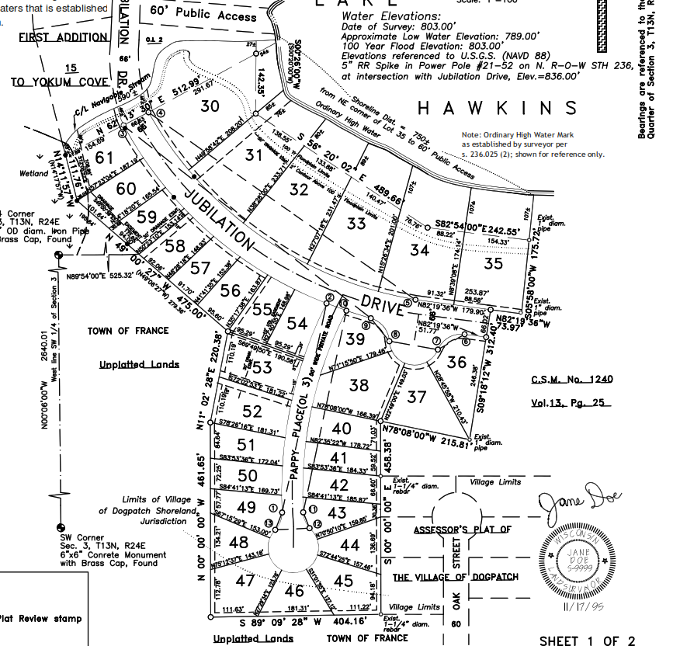
4. Tangency Condition - Example Plat

Slide 13
5. Intersections
a. Arc-Direction
Baseline: A and arc Radius point, O₁
Direction at A
Radius (distance) at O₁
Same as Distance-Direction intersection
P₂
P₁
dir_{AC}
R
R
A
O

Slide 14
5. Intersections
b. Arc-Arc
Baseline: Arc Radius points, O₁ and O₂
Distances are the respective radii.
Same as Distance-Distance intersection
P₁
R₁
R₂
O₁
O₂
R₁
R₂
P₂

